Slide 1
Supporting School Staff Wellbeing with Acceptance & Commitment Therapy (ACT)
Dr Freddy Jackson Brown
Positive Behaviour Solutions
freddy@behavioursolutions.net

Slide 2
Starting at the end
Key message - in order to deliver high quality services, we need to be serious about supporting staff wellbeing
The whole person, not just employee
Notes:
The French filmmaker Jean Luc Goddard once said every story should have a beginning, middle and end, but not necessarily in that order.
Now although this presentation has nothing to do with French avant-garde films, I’m going to follow Godard’s artistic sensibility and start my presentation at the end.
It will have a beginning and a middle too but I think the end message is so important that I want to repeat it at every opportunity.
So here it is - if we want the best services for our clients, we need to be serious about supporting staff well-being. Not just lip service
In this presentation I’m going to describe one example of how we can do that
I’m gig to describe how we implemented a staff well-being program based on the Acceptance and Commitment Therapy (ACT) model. I will describe the ACT model and how we adapted it to work in special schools in Bristol
And hopefully by the end, I’ll have highlighted the importance of supporting staff wellbeing
When I’m talking about staff wellbeing it is the wellbeing of the whole person, not just the employee – issues are not limited to work settings

Slide 3
Acceptance and Commitment Therapy (ACT)
‘Third wave’ behaviour therapy
Acceptance and mindfulness alongside values guided behaviour change strategies to increase ‘psychological flexibility’
Based on Relational Frame Theory (RFT)
Notes:
Psychological flexibility means contacting the present moment fully as a conscious human being, and based on what the situation affords, changing or persisting in behaviour in the service of chosen values

Slide 4
An RFT Primer
RFT is a behaviour analytic theory – BF Skinner
Generalised Relational Responding
Relational Frames are generalised verbal operants
Implications of RFT …..
Notes:
treats relational responding as a generalized operant, and thus appeals to a history of multiple-exemplar training. Specific types of relational responding, termed relational frames, are defined in terms of the three properties of mutual and combinatorial entailment, and the transformation of functions. Relational frames are arbitrarily applicable, but are typically not necessarily arbitrarily applied in the natural language context
Verbal relations are reversible, then
Thought suppression

Slide 5
Thinking about Polar bears
"Try to pose for yourself this task: not to think of a polar bear, and you will see that the cursed thing will come to mind every minute.” Dostoevsky
Daniel Wegner (1987) & thought suppression
Notes:
1863 Fyodor Dostoevsky wrote in Winter Notes on Summer Impressions, "Try to pose for yourself this task: not to think of a polar bear, and you will see that the cursed thing will come to mind every minute." When the psychologist Daniel Wegner put this question to experimental test, he found that Dostoevsky was right. Since this study was published in 1987 it has been repeated and varied many times and the results consistently show that we just can’t avoid our thoughts by trying to think something else. Whenever we try not to think of it, we think of it all the more.

Slide 7
Defining Wellbeing
Our broad sense of contentment, purpose and meaning
Not a specific feeling, general sense that ‘life is going in the right direction’
Linked to health, happiness, vitality and….workplace productivity
Notes:
Stress linked to range of physical and psychological health problems – and early death
lost as a result of work-related stress, anxiety and depression during 2013/14 – an average of 23 days of work lost per case
Work related stress major issue and while stress management training programmes do exist, few access them

Slide 8
Stress and Distress
Stress – general term for poor wellbeing and linked to measures of ‘psychological distress’
Stress big problem …and it kills, literally
In the UK 39 per cent of recorded cases of work-related health conditions were stress related
More than 11 million working days lost - 23 days per case
Notes:
Stress - the opposite of wellbeing
Distress – unhappiness, anxiety, low mood, physical illnesses
Stress is not just when demands outstrip capacity. Can be stressed when you have very little to do
23 days per case

Slide 9
How bad is it?
UK Studies show 25% and 40% of workers in various occupational groups could be diagnosed with a ‘minor psychiatric disorder’ – mostly anxiety and depression (Hardy, Woods, & Wall, 2003; Stride, Wall, & Catley, 2007)
Notes:
What does this mean?
Drugs companies would love to diagnose us all with something!

Slide 10
Impact of Stress in Schools
Undermines teacher wellbeing and health (Teacher Wellbeing, 2009)
Commitment to remain in the profession (TES, 2015)
Quality of care and effectiveness (Biglan, 2012)
Staff turnover (Hatton & Emerson, 1998)
Positive learning environment (Mehta, 2013)
Notes:
Challenging behaviour increases the risk of experiencing occupational stress and burnout (Hastings, 2002)

Slide 11
Why support staff wellbeing?
Happy staff are effective staff
Absenteeism and presenteeism
Uk workforce review concluded “Good mental health [i.e., wellbeing] is good business” (Black, 2008)
Need to support whole person, not just employee
Notes:
Ok so they are unhappy, but how is that my problem?
Why whole person – not just making positive work environment, need whole person
Doesn’t mean going home with someone and ding their shopping and ironing – rather look to support their general functioning
Can be cynical – really about me or making your service better?

Slide 12
Special schools are great places!
Full of amazing kids, committed, skilled and hardworking staff, and wonderful parents
AND…..lots of stress
Sources of stress – lots to do, sometimes unpleasant tasks, management, personal issues
And sometimes aggression & challenging behaviour

Slide 13
What can be done?
To deliver high quality services we need to be serious about support staffing wellbeing
Ok, how?
External issues – PBS principles for staff
Internal barriers – thoughts and feelings
Notes:
Lots of stress management training programmes, but not made readily available by organisations
External barriers – Sandy Toogood wisdom – apply same PBS principles for staff as for clients – need to set up context that support positive behaviours and wellbeing
Internal barriers – Robert Sapolsky’s Why Zebra’s Don’t Get Ulcers (1994) makes the following argument
A lion chasing a zebra starts rush of hormones that put Z’s body into high gear. Once away from the lion, the body returns to normal
Humans are different. Our language ability means we can be in the presence of threatening stimuli all the time. We can think of times when things went wrong or we did something daft and worry about. We can bring painful, distressing and stressful events into the present by thinking about them.
For example, have you ever ruminated on a dispute with a work colleague and then lain in bed worrying about it? Or worried about something that might happen in the future?
When we do this we bring stressful stimuli into our lives and our bodies react. Quite naturally, but long term stress is bad for us – heart problems, IBS, insomnia, ulcers, irritability, miscarriages, drug and alcohol misuse

Slide 14
The importance of thoughts and feelings
Thoughts and feelings matter!
Why Zebra’s don’t get ulcers (Robert Sapolsky, 1994)
How we respond to internal stimuli that is critical
Avoidance of negative internal content can lead to problems – fusion and experiential avoidance
Notes:
BA not traditionally studied thoughts and feelings as did not have a robust framework for doing so – but now have RFT
Thoughts and feelings are not causes!

Slide 15
Fusion and Experiential Avoidance
Fusion – the domination of the literal content of language
Experiential avoidance (EA) – being unwilling to remain in contact with particular private experiences and trying to alter the form or frequency of these events (and the contexts that occasion them) even when doing so causes psychological harm

Slide 16
Acceptance and Commitment Therapy (ACT)
Based on recent breakthroughs in how language works (see Relational Frame Theory, RFT)
A new evidence based framework that uses mindfulness alongside values clarification and behavioural activation techniques
An ABA technology!
Notes:
Say a bit about the ACT model
Can’t change thoughts and feelings and end up in a futile struggle trying to do so

Slide 17
Psychological Flexibility
Aim is to increase psychological flexibility (and reduce influence of fusion and EA)
‘the ability to contact the present moment more fully as a conscious human being, and to change or persist in behaviour when doing so serves valued ends’ (Hayes et al., 2006)
Being open, aware and active
Notes:
The emphasis is on letting go of the tendency to control thoughts and feelings as a prerequisite to pursuing valued goals
making room for unwanted internal events, clarifying what is truly important and committing to meaningful behavioural changes
Uses mindfulness and acceptance processes to develop skills that help to change a person’s relationship with their painful thoughts and feelings, thereby reducing their influence on what we do
Value clarification, goal setting and taking actions are termed commitment and behaviour change processes

Slide 18
Aware, Open & Active
Awareness - increasing your connection with the world around you rather than living in your head (mindfulness)
Openness - stepping forward into life and accepting all that comes with it (acceptance processes)
Active - doing the things that truly matter to you (values based action)

Slide 19
1. Being Aware and Open
Practice being aware and open with mindfulness and acceptance processes
Mindfulness means paying active attention to what is happening in the present moment, openly and without resistance
Involves slowing down so that you can connect with what’s happening around you
A form of secular meditation – lots of exercises
Notes:
Harder than you think – minds hook us away from the present moment
The emphasis is on letting go of the tendency to control thoughts and feelings as a prerequisite to pursuing valued goals
making room for unwanted internal events, clarifying what is truly important and committing to meaningful behavioural changes
Uses mindfulness and acceptance processes to develop skills that help to change a person’s relationship with their painful thoughts and feelings, thereby reducing their influence on what we do

Slide 20
2. Active: values & doing what matters
Values reflect our deepest desires about what matters to us. They provide us with the guidance and direction for how we want to behave in our day-to-day lives
Values are on-going qualities of action, for example being loving, committed, kind or playful.
Not goals or feelings
Notes:
Being loving – making my wife a cup of tea, buying flowers, getting married are goals
Goals can be achieved, values are life directions, like points on a compass
In our culture which emphasizes happiness as the top goal, its not surprising that people want to be happy.
But wanting to feel certain things and not others is at the heart of the problem! This is why people go down the unworkable route of trying to control their feelings, doomed to failure as its just not possible to control how we feel

Slide 21
Example: Card Sort Values Clarification exercise
Given 50 values cards and sort them into three piles
PILE 1: These values are not very important to me.
PILE 2: These values are of moderate importance to me.
PILE 3: These values are of highest importance to me.

Slide 22
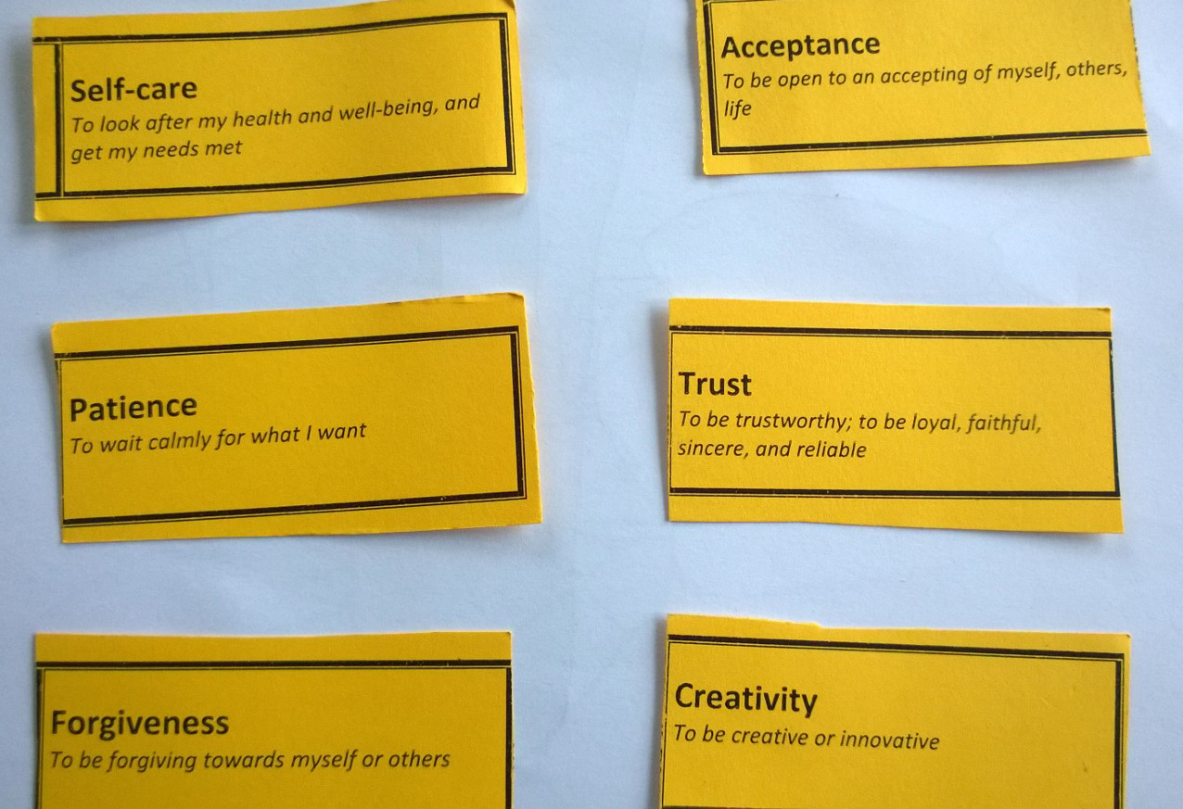
Values Based Action

Slide 24
Values Based Actions
The process of doing the things that matter to you
Behavioural activation
Can control actions, not thoughts and feelings
Notes:
Unlike our thoughts and feelings, actions are generally under our personal control and so values can be a really useful guide for how to respond in any given situation, especially when difficult thoughts and feelings are around

Slide 25
Evidence for ACT in workplace
Effective for reducing psychological distress in the workplace (Flaxman & Bond, 2010).
Mindfulness is an effective workplace intervention for stress reduction (Grossman, 2003)
How do get ACT into school settings?
Find effective delivery format in which to deliver it – our challenge!
Notes:
Combining mindfulness and personally-valued action is an effective way of improving wellbeing and behavioural effectiveness
how do get ACT into school settings? Very busy places and reality is that staff wellbeing not to top priority
Find effective delivery format in which to deliver it – our challenge!

Slide 26
How can ACT ‘work’ in special school setting?
Paul Flaxman’s ‘2+1’ model – 3 half days
No funding for half or whole day training event
Training on inset days? Too many other priorities
Before or after school? People have lives to live

Slide 27
Our Solution
7 week programme (Based on Noone & Hastings PACT model)
First session 60 minutes, thereafter 2 x 30 minutes sessions/week (Tuesday and Thursday)
Each session started with mindfulness exercise. Then used experiential exercises to address key areas of ACT.
Second weekly session reviewed home practice and longer mindfulness exercise
Notes:
Promotion of Acceptance in Carers and Teachers (PACT)
Each session scripted

Slide 28
Timetable
Week 1. Session 1 Introduction to stress and wellbeing
Session 2 Mindfulness exercise
Week 2. Session 1 Values, purpose and goals in life
Session 2 Mindfulness exercise
Week 3. Session 1 The Cost of Experiential Avoidance
Session 2 Mindfulness exercise
Week 4. Session 1 Willingness
Session 2 Mindfulness exercise
Week 5. Session 1 Defusion
Session 2 Mindfulness exercise
Week 6. Session 1 Feelings and Causes
Session 2 Mindfulness exercise
Week 7. Session 1 Committed Action and Summary
Session 2 Mindfulness exercise

Slide 29
Who and Where?
48 staff working with deaf children and children with learning disabilities
Staff allocated to intervention and control group according to schools
15 staff from two Bristol special schools and 9 from school for the deaf. 24 staff in control group from another special school
Right after school - 3.30pm -4pm (one group then shifted to 4-4.30pm)
Notes:
quasi experimental design as not fully randomised

Slide 30
Participant Profile
Gender
Age
Job title
Hours per week
Years of experience
Qualifications
Strategies
Current Stress

Slide 31
Measures
The General Health Questionnaire (GHQ-12) is a 12-item questionnaire which asks participants to respond to statements regarding their recent general well-being
The Staff Stressor Questionnaire (SSQ) is a 33-item questionnaire designed for staff working in intellectual disability services
The Mindful Awareness Attention Scale (MAAS) asks participants to rate the frequency of everyday experiences relating to being mindful
The Perceived Stress Scale (PPS) is a 10-item scale that measures the degree to which life situations are appraised as being stressful

Slide 32
Outcomes
Attendance rate 94% (range 10-100%)
Drop outs – 3/24 in intervention group
Why?
1 injured back and off work
1 stopped after 2 sessions – too busy
1 stopped after 5 sessions – no reason given

Slide 33
Feedback
“Really helpful to look at putting my values into action”
“Enjoyed it” “Mindfulness very relaxing”
“I’d like to do it every week!”
“Didn’t get the raisin thing”
Notes:
Mostly positive feedback

Slide 34
Raw Data
Questionnaire | Baseline Control (BC) | Baseline | Baseline Intervention (BI) | Post Intervention (PI) | t test
GHQ | 12.35 | 11.55 | 13.842 | 8.474 | 0.003547**
SSQ | 67.7917 | 70.5909 | 71.11905 | 57.958 | 0.01266**
PSS | 14.88 | 14.16 | 16.43 | 13.48 | 0.00988**
MAAS | 60.566 | 61.79 | 59.979 | 64.369 | 0.1797
Notes:
Not fully analysed – Positive change in intervention group outcomes, but not on mindfulness measure
Southampton University support

Slide 35
Issues
Took longer than planned - 10 weeks to complete due to bank holidays and OFSTED visit . For some staff – loss of focus and momentum
Enough practice? Klatt et al (2009) low dose hourly mindfulness-based intervention over 6 weeks – positive change
This programme was 7.5 hours total & about 2.5 hours mindfulness practice – too little?
30 minutes sessions too short - 45 minutes would be better
Notes:
Individual data suggests more improved MAAS scores for those who were more engaged - did more home practice

Slide 36
What does it mean?
Pilot study which shows signs of promise
Clear need for staff support, our challenge is to find models that work
Impact for children?

Slide 37
Next Steps
Try again! –
"No matter how many mistakes you make or how slow you progress, you are still way ahead of everyone who isn't trying." - Tony Robbins (Thanks to Chris Howe)
New study in Bristol schools underway

Slide 38
The end (again)
In order to deliver high quality services
we need to be serious about supporting staff wellbeing

Slide 39
Thank you for listening
Any questions?

Slide 40
References
Biglan, A., Layton, G. L., Jones, L. B., Hankins, M., & Rusby, J. C. (2013). The value of workshops on psychological flexibility for early childhood special education staff. Topics in Early Childhood Special Education. 32(4) 196–210.
Hatton, C., Emerson, E., Rivers, M., Mason, H., Mason, L., Swarbrick, R., Kiernan, C., Reeves, D., & Alborz, A. (1999). Factors associated with staff stress and work satisfaction in services for people with intellectual disability. Journal of Intellectual Disability Research, 43, 253-267.
Hastings, R. P. (2002). Do challenging behaviors affect staff psychological well-being?: Issues of causality and mechanism. American Journal on Mental Retardation, 107, 455-467.
Hardy GE, Woods D and Wall TD (2003) The impact of psychological distress on absence from work. Journal of Applied Psychology 88: 306–314.
Hatton, C., & Emerson, E. (1998). Organisational predictors of actual staff turnover in a service for people with multiple disabilities. Journal of Applied Research in Intellectual Disabilities, 11, 166-171.

Slide 41
Klatt, M. D., Buckworth, J., & Malarkey, W. B. (2009). Effects of low-dose mindfulness-based stress reduction (MBSR-ld) on working adults. Health Education & Behavior, 36, 601-614.
Mehta, T. G., Atkins, M. S., Frazier , S.L. (2013). The Organizational Health of Urban Elementary Schools: School Health and Teacher Functioning. School Mental Health.
Male, D.B. & May, D.S. (1997) Burnout and Workload in Teachers of Children with Severe Learning Difficulties. British Journal of Learning Disabilities, 25, 117-121.
Hinds, E. (2013) The role of experiential avoidance in teacher stress and mental health. Doctoral dissertation.
Stride C, Wall TD and Catley N (2007) Measures of Job Satisfaction, Organisational Commitment, Mental Health and Job-Related Well-Being: A Benchmarking Manual. Chichester: Wiley.
Teacher Exodus Survey (2015) - http://teachersupport.info/research-policy/research-reports/retention-rates

Slide 42
How ACT builds Psychological Flexibility
Practice shifting from “automatic pilot” to “mindful awareness”
Clarify personal values – the qualities you most want to express in your behaviour
Engage in small, value-inspired actions
Notes:
Practice shifting from “automatic pilot” to “mindful awareness.” This is about learning ways to handle difficult thoughts and feelings effectively, so they have less impact and influence on you
Connect with your personal values – clarify the qualities you most want to express in your behaviour
Engage in small, value-inspired actions. This leads to a renewed sense of meaning, purpose and wellbeing as well as enhancing productivity

